Slide 1
GENERALIZED LINEAR MODELS- NEGATIVE BINOMIAL GLM and its application in R
Malcolm Cameron
Xiaoxu Tan

Slide 2
Table of Contents
Poisson GLM
Problems with Poisson
Solutions to this Problem
Negative Binomial GLM
Data Analysis
Summary

Slide 3
2. Poisson
Let Yi be the random variable for claim count in the ith class, i = 1,2 ..... N, The mean and the variance are both equal to λ

Slide 4
Poisson Continued
Mean and variance are both equal
Memoryless Property
Commonly used because of its convenience and appropriateness.
Many Statistical Packages available
Poisson Distribution can be used for
Queuing theory
Insurance claims
Any count data

Slide 5
3. Problems with Poisson
Over dispersion and heterogeneity of the distribution of residuals.
MLE procedure used to derive estimates and provide the standard errors of those estimates make strong assumptions that every subject within a covariate group has the same underlying rate of outcome (homogeneity).
The model assumes that the variability of counts within a covariate group is equal to the mean
So if the variance is greater than the mean, this will lead to underestimated standard errors and overestimated significance of regression parameters

Slide 6
4. Solutions to This Problem
But don’t worry!
(1) Fit a Poisson quasi likelihood.
(2) Fit Negative Binomial GLM.
We will be focusing on the second method

Slide 7
5. Negative Binomial
The pmf is
k ∈ { 0, 1, 2, 3, … } — number of successes

Slide 8
Negative Binomial Continued
Under the Poisson the mean, λ_{i}, is assumed to be constant within classes. But, if we define a specific distribution for λ_{i}, heterogeneity within classes can be used.
One method is to assume λ_{i} to be Gamma with E(λ_{i})= µ_{i} and Var(λ_{i})=µ_{i} ² / v_{i}
And Y_{i} | λ_{i} to be the Poisson distribution with conditional mean E(Y_{i} | λ_{i} )= λ_{i}

Slide 9
Negative Binomial Continued
It follows that the marginal distribution of Y_{i} follows a Negative Binomial distribution with PDF
Where the mean is E(Y_{i})= µ_{i} and Var(Y_{i})= µ_{i} + µ_{i}² v_{i}⁻¹

Slide 10
MLE for NB GLM
Different parameterization can result in different types of negative binomial distributions.
For Example, by letting v_{i} = a⁻¹ , Y follows a NB with E(Y_{i})= µ_{i} , and Var(Y_{i}) = µ_{i}(1+a µ_{i}) where a denotes the dispersion parameter.
Note: If a=0, there would be no over dispersion.
The log likelihood for this example would be

Slide 11
MLE for NB GLM Continued
And the Maximum likelihood estimates are obtained by solving the following equations
and

Slide 12
Negative Binomial Continued
The MLE may be solved simultaneously, and the procedure involves sequential iterations.
In (1), by using the initial value a, a₍₀₎, l(β,a) is maximized w.r.t β, producing β₍₁₎.
The First equation is equivalent to the weighted least squares, so with slight adjustments, the MLE can be found using Iterated Weighted Least Squares (IWLS) regression, similar to the Poisson.
In (2), we treat β as a constant to solve for a₍₁₎ . This can be done using the Newton-Raphson algorithm
By cycling between these two processes of updating our variables, the MLE for β and a will be obtained.

Slide 13
6 .Data Analysis
Find data set with over dispersion.
Do analysis using Poisson and NegBinomial
Compare the models

Slide 14
Example: Students Attendance
School administrators study the attendance behavior of high school juniors at two schools.
Predictors:
The type of program in which the student is enrolled
The students grades in a standardized math test

Slide 15
The Data
nb_data---The file of attendance data on 314 high school juniors from two urban high schools
Daysabs---The response variable of interest is days absent
Math ----The variable gives the standardized math score for each student.
Prog --- is a three-level nominal variable indicating the type of instructional program in which the student is enrolled.

Slide 16
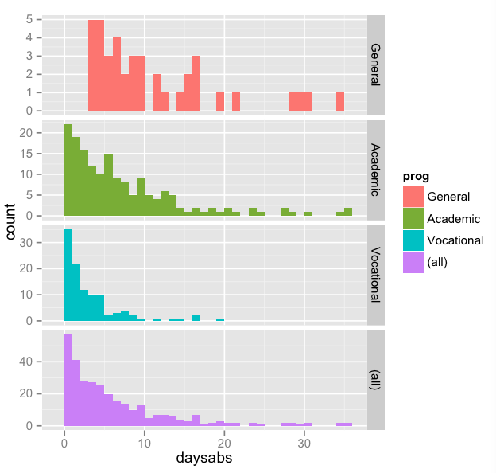
Plot the data!

Slide 17
6.1 fit the Poisson model
Poisson1 <- glm(daysabs ~ math + prog, family = "poisson", data = students)
summary(Poisson1 )
Call:
glm(formula = daysabs ~ math + prog, family = "poisson", data = students)
Coefficients:
Estimate Std. Error z value Pr(>|z|)
(Intercept) 2.651974 0.060736 43.664 < 2e-16 ***
math -0.006808 0.000931 -7.313 2.62e-13 ***
progAcademic -0.439897 0.056672 -7.762 8.35e-15 ***
progVocational -1.281364 0.077886 -16.452 < 2e-16 ***
Signif. codes: 0 ‘***’ 0.001 ‘**’ 0.01 ‘*’ 0.05 ‘.’ 0.1 ‘ ’ 1
(Dispersion parameter for poisson family taken to be 1)
Null deviance: 2217.7 on 313 degrees of freedom
Residual deviance: 1774.0 on 310 degrees of freedom
AIC: 2665.3
Number of Fisher Scoring iterations: 5

Slide 18
because the mean value of daysabs appears to vary by progress.
with(students, tapply (daysabs, prog, function(x) {
sprintf("Mean (Var) = %1.2f (%1.2f)", mean(x), var(x))
General Academic Vocational
"M (SD) = 10.65 (8.20)" "M (SD) = 6.93 (7.45)" "M (SD) = 2.67 (3.73)"
Poisson regression has a very strong assumption, that is the conditional variance equals conditional mean. But The variance is much greater than the mean,
So...

Slide 19
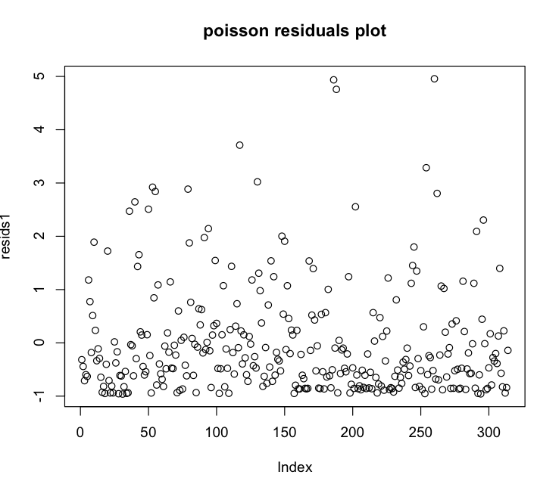
Plot the data

Slide 20
So we need to find a new model…
Negative binomial regression can be used ,when the conditional variance exceeds the conditional mean.

Slide 21
6.2 fit the negative-binomial model
> NB1=glm.nb(daysabs ~ math + prog, data = students)
> summary(NB1)
Call:
glm.nb(formula = daysabs ~ math + prog, data = students, init.theta = 1.032713156,
link = log)
Deviance Residuals:
Min 1Q Median 3Q Max
-2.1547 -1.0192 -0.3694 0.2285 2.5273
Coefficients:
Estimate Std. Error z value Pr(>|z|)
(Intercept) 2.615265 0.197460 13.245 < 2e-16 ***
math -0.005993 0.002505 -2.392 0.0167 *
progAcademic -0.440760 0.182610 -2.414 0.0158 *
progVocational -1.278651 0.200720 -6.370 1.89e-10 ***
---
Signif. codes: 0 ‘***’ 0.001 ‘**’ 0.01 ‘*’ 0.05 ‘.’ 0.1 ‘ ’ 1
(Dispersion parameter for Negative Binomial(1.0327) family taken to be 1)
Null deviance: 427.54 on 313 degrees of freedom
Residual deviance: 358.52 on 310 degrees of freedom
AIC: 1741.3
Number of Fisher Scoring iterations: 1

Slide 22
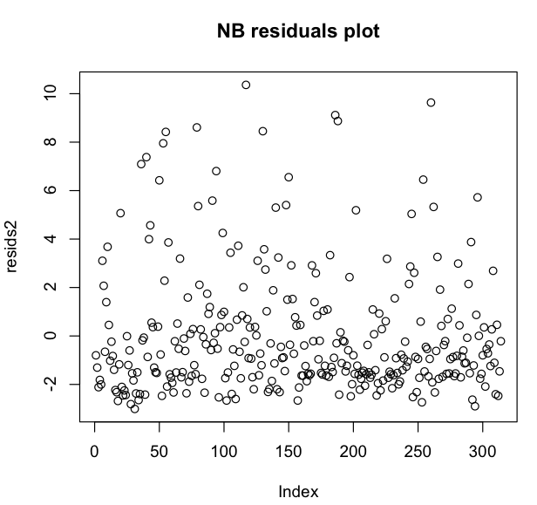
Plot the data !

Slide 23
7. Check model assumptions
We use the likelihood ratio test
Code:
Poisson1 <- glm (daysabs ~ math + prog, family = "poisson", data = students)
> pchisq(2 * ( logLik(poisson1) - logLik(NB1)), df = 1, lower.tail = FALSE)
[1] 2.157298e-203
This strongly suggests the negative binomial model is more appropriate than the Poisson model !

Slide 24
8. Goodness of fit
*for poisson
resids1<-residuals(poisson1, type="pearson")
sum(resids1^2)
[1] 2045.656
1-pchisq(2045.656,310)
[1] 0
*for negative binomial
resids2<-residuals(NB1, type="pearson")
sum(resids2^2)
[1] 339.8771
> 1-pchisq(339.8771,310)
[1] 0.1170337

Slide 25
9. AIC –which model is better?
> AIC(Poisson1)
[1] 2665.285
> AIC(NB1)
[1] 1741.258
For negative binomial, it has Much smaller AIC!

Slide 26
Thank you !

